Slide 1
Visor
An academic advising tool
Fernando Gomez Garcia
Megan Kolvenbach
Scott Levy

Slide 2
Introduction/Project Background
VISOR can serve as an advising tool for colleges and universities
Can streamline and simplify a process that can normally be cumbersome
An advisor would normally have to manually match up a student’s course history with their program requirements to devise course plans
VISOR is meant to automate that process, by allowing an advisor to simply input a student’s ID#
Notes:
Scott

Slide 3
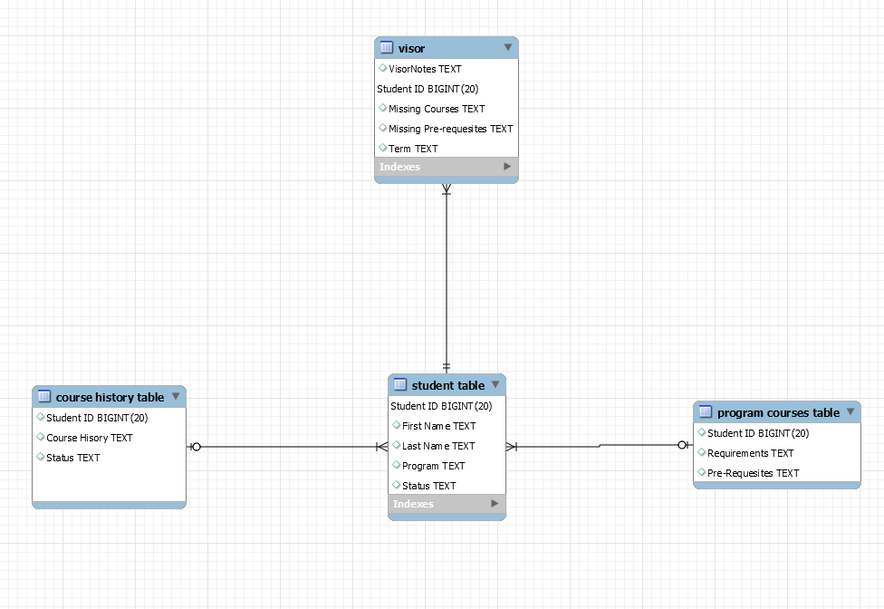
UML
Four main sources to run the program
All table connect through a one to many relationship
The visor table retrieves the information from the student table which then will have access to the program course and course history table.
The form in which all sources are able to connect to each other is through a primary key, a common key between two or more tables.
Notes:
Fernando

Slide 4
Module Framework
AdvisingNotes
Allows for various customized notes to be printed to the student’s advising summary based on the student’s identifying information, course history, and academic performance
Course
Provides template for individual courses to be included in the degree program requirements
CourseHistory
Creates an object of type Hospitality called requirements. Constructor then takes input and sets various requirements as satisfied or remaining. The class then applies prerequisites according to the requirements outlined in the Hospitality class.
Hospitality
Provides course requirements and prerequisites dictated by the B.S. in Hospitality Management program at UNLV
Student
Provides template to store students’ identifying information, degree program, and academic history
Notes:
Megan

Slide 5
Input
.csv file
Student demographics and academic information
Y or N to indicate if a course has been satisfied
See snippet below
Command line input
User indicates what type of course plan to be generated based on provided list
Notes:
Scott

Slide 6
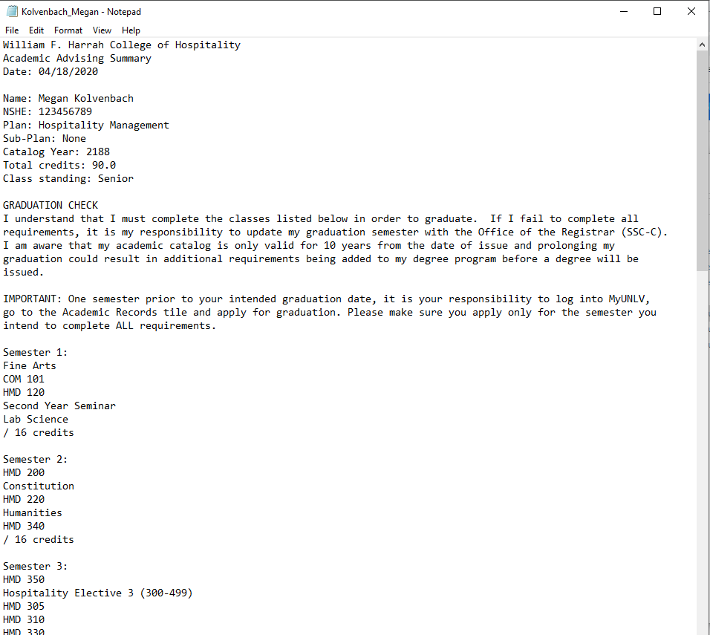
Output
.txt file
Advising summary customized to selected student and type of course plan
Notes:
Scott

Slide 7
Live Demonstration
Notes:
Megan

Slide 8
Future Directions
Serves as a tool that maximizes efficiency and accuracy and more ways to store and retrieve information
This program would allow great opportunities to increase the performance and automate a whole section of, if not whole, departments.
Additionally, attaching a graphical user interface to the program including one search box which would serve to search the student ID and another box asking for the advisor to input their name is a foreseeable option
VISOR will boost efficiency and accuracy making it possible to add more flexibility to current staff members.
Notes:
Fernando

